Slide 1


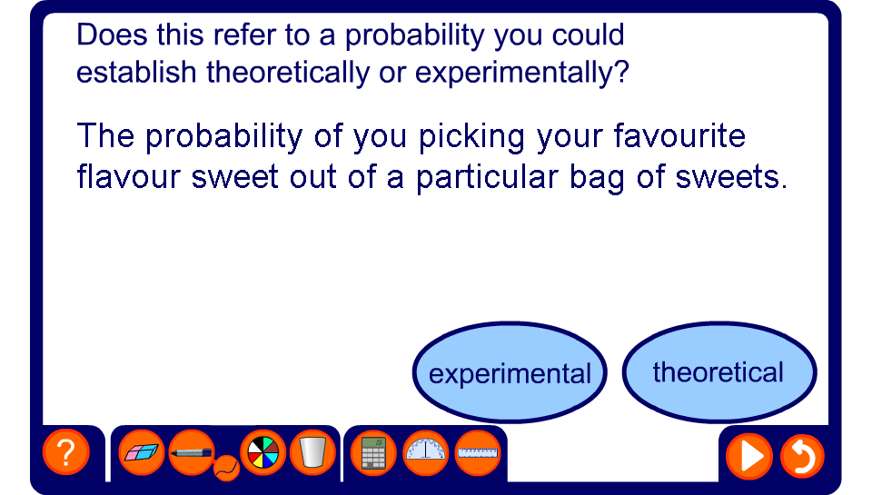


Experimental and theoretical probability

